Slide 1
AGA Clinical Practice Update on Management of Subepithelial Lesions Encountered During Routine Endoscopy: Expert Review
Clinical Gastroenterology and Hepatology 2022;

Slide 2
Subepithelial lesions (SELs)
Subepithelial lesions (SELs) of the gastrointestinal (GI) tract are masses, bulges, or impressions in the GI lumen that are covered with normal-appearing epithelium.
These lesions can originate from the muscularis mucosa, submucosa, or muscularis propria (MP) of the GI tract, or they can be extraluminal.
SELs are found in 1 in every 300 endoscopies, and two-thirds of these lesions are located in the stomach.
They represent a heterogenous group of lesions including non-neoplastic lesions such as ectopic pancreatic tissue and neoplastic lesions. The neoplastic SELs can vary from lesions with no malignant potential such as lipomas to those with malignant potential such as gastrointestinal stromal tumors (GISTs).
The majority of SELs are small and found incidentally. The most common symptoms, when present, are GI bleeding and abdominal pain. Rarely they can cause bowel obstruction or present with metastasis.

Slide 3
Diagnosis
Endoscopy
Forceps Biopsy
Endoscopic Ultrasound
EUS-Guided Fine-Needle Aspiration and Fine-Needle Biopsy

Slide 4
Endoscopy
lipomas can have a characteristic “pillow sign” that occurs when forceps push into the lesion, resulting in a depression.
pancreatic rests are commonly an antral subepithelial mass with central umbilication measuring 6–10 mm in diameter and located 2–6 cm from the pylorus along the greater curvature

Slide 5
Forceps Biopsy
standard biopsy forceps are often non-diagnostic.
Bite-on-bite “tunneling” biopsies, using large capacity or jumbo forceps (jaw volume 12–13 mm3), has been described with diagnostic yield of 30%–40%.
lesions arising from the third layer (submucosa), with diagnostic yield in the range of 55%–65%, and is comparable to endoscopic ultrasound (EUS) with fine-needle aspiration (FNA).
The advantage of jumbo forceps is lower (40%) in lesions arising from the MP.
complicated by bleeding,which can be seen in up to one-third of cases.

Slide 6
Endoscopic Ultrasound
the method of choice for the characterization of SELs of the upper GI tract as an adjunct to standard endoscopy.
2 roles :
to characterize whether a lesion is intramural or extramural, the layer of origin, size, echogenicity of the lesion, and presence of blood vessels on Doppler flow,
tissue acquisition.

Slide 7
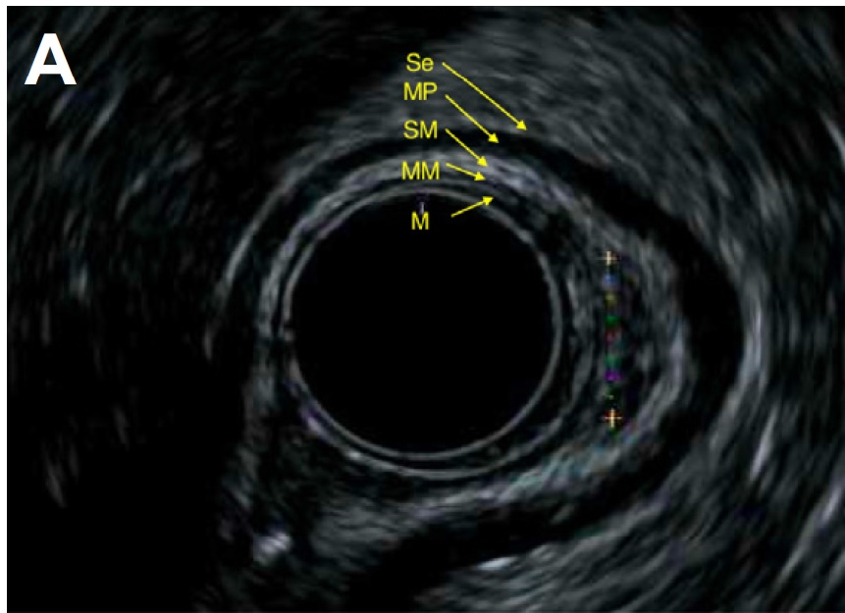
Endoscopic Ultrasound
EUS reveals a 5-layer pattern numbered from the lumen out:
1: mucosa
2: muscularis mucosa; lipomas, carcinoids, or pancreatic rests,
3: submucosa
4: MP ; GISTS or leiomyomas
5: serosa or adventitia

Slide 8
Endoscopic Ultrasound
Echogenicity
1- Anechoic ; cysts, varices, or lymphangiomas.
2-Hypoechoic ; mesenchymal tumor, granular cell tumor, neuroendocrine tumor, metastatic disease, lymphoma, infiltrative diseases, inflammation, and endometriosis (in rectosigmoid EUS).
3-Hyperechoic ; lipomas or fibrolipomas
4- Mixed echogenicity ;pancreatic rest, malignant mesenchymal tumors, or GI tract wall

Slide 9
EUS-Guided Fine-Needle Aspiration and Fine-Needle Biopsy
FNA and FNB ; diagnostic accuracies of 46%–93%.
size of the FNA-FNB target.
2 cm and 2–4 cm is 71% and 86%
4–5 cm the accuracy is 95%–100%.
needle sizes (19-gauge, 20-gauge, 22-gauge, and 25-gauge).
Large-bore needles (19-gauge and 20-gauge) –higher tissue yield but are more difficult to maneuver
Twentytwo– gauge and 25-gauge needles are more maneuverable in various scope positions and more favorable to use.

Slide 10
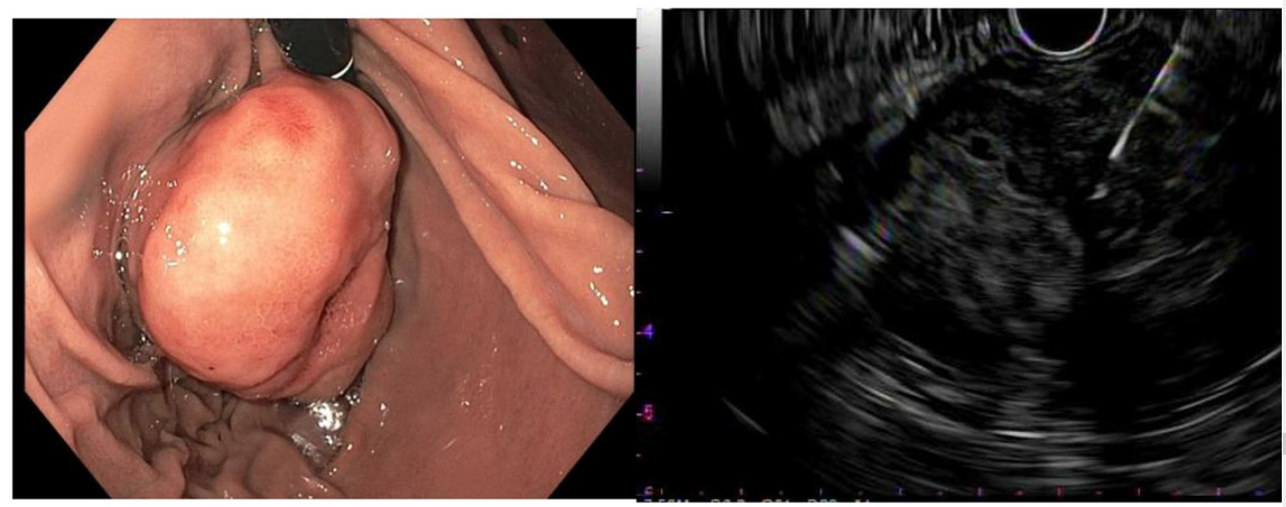

Slide 11
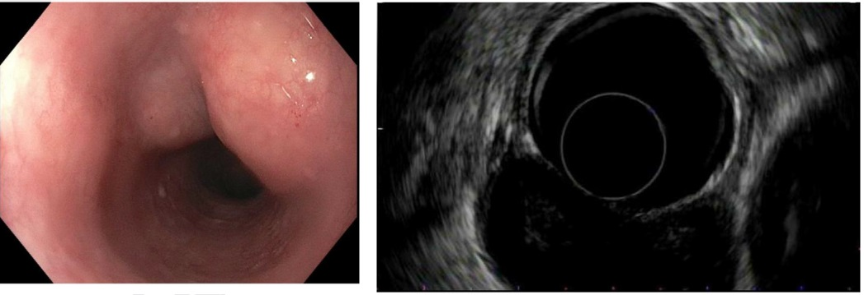

Slide 12
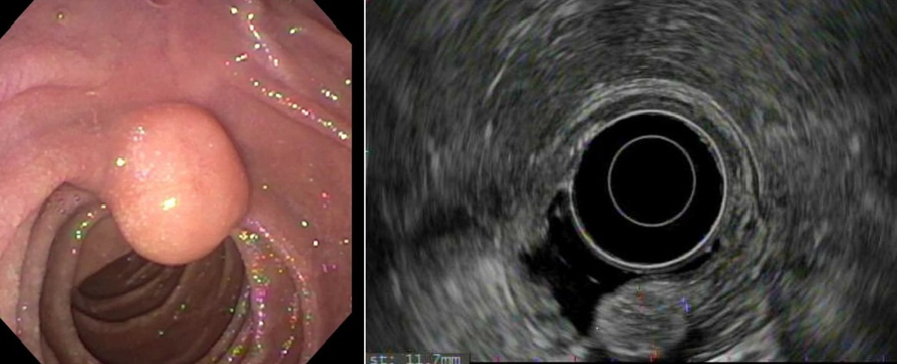

Slide 14
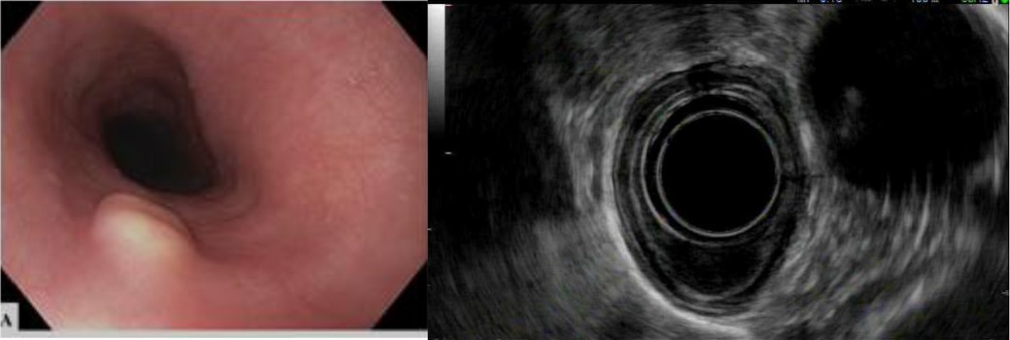

Slide 17
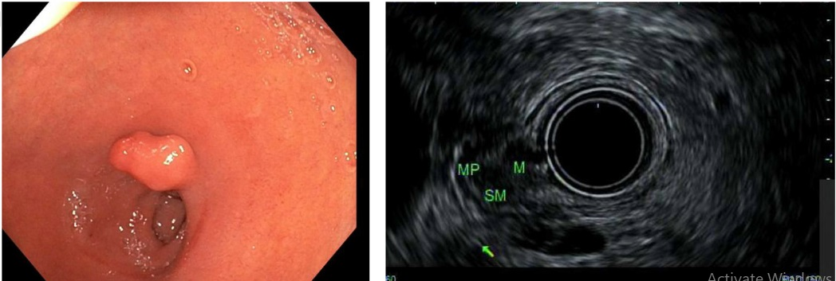

Slide 21
Endoscopic Resection Techniques
There are multiple different techniques described for endoscopic resection of SEL and can be categorized into exposed vs non-exposed with reference to breach of MP and exposure to extraluminal space.
The method used is often determined by the layer in which the lesion is situated, size, and location. The ultimate goal of endoscopic resection is to have a complete resection (R0).
Determining the layer of involvement by EUS is critical in planning resection techniques.

Slide 22
Endoscopic Submucosal Resection
Endoscopic submucosal resection (ESMR) allows for removal of lesions up to 20 mm in size arising from mucosa or submucosa.
Cap-assisted technique involves suctioning the lesion into a cap and resecting the lesion with a preloaded snare.
ESMR with ligation involves ligating the base of the lesion using a band or endoloop, followed by resection using a snare.
These techniques harbor a bleeding risk of 4%–13% and perforation risk of 5%

Slide 24
Endoscopic Submucosal Dissection
Endoscopic submucosal dissection (ESD) has been used for removal of selective SELs confined to the muscularis mucosa or submucosa such as gastric carcinoids and granular cell tumors.
ESD is an exposed technique in which the overlying mucosa is resected along with the lesion itself.
ESD techniques are indicated for lesions that are easily accessible for knife manipulation as well as closure techniques and devices such as the esophagus, body of the stomach, or rectum.
ESD could be used in difficult positions such as duodenum in selected patients and when done by expert hands

Slide 26
Submucosal Tunnel Endoscopic Resection
Submucosal tunnel endoscopic resection (STER) is a non-exposed technique that can be used for deeper lesions in which there is risk for MP involvement and consequent perforation
STER is ideally used in locations in which scope manipulation for ESD techniques may be difficult such as the cardia or proximal gastric fundus.
. SEL size can be a limitation in STER, because lesions larger than 3–4 cm can be difficult to remove from the tunnel

Slide 28
Endoscopic Full-Thickness Resection
When the lesion involves the MP and/or extends into the extraluminal space, complete lesion resection using the methods described above is known as FTR
The term FTR has now come to mean that a close-and-resect order will be used to avoid the impending perforation caused by full-thickness removal.
Limitations to use of these devices are size of the lesions to those that can be fit into the caps, the ability to maneuver the scope and device to the lesion itself, and finally the ability to manipulate the lesion into the cap.

Slide 31
Management of Common Subepithelial Lesions
Lipomas have distinct endoscopic and endosonographic features. Tissue sampling and surveillance are not required for these lesions.
Pancreatic rests have typical endoscopic appearance.These lesions are generally benign and do not require surveillance. Larger lesions rarely cause pain or bleeding necessitating endoscopic or surgical removal
Duplication cysts of the foregut are typically asymptomatic and have characteristic endosonographic appearance. EUS-FNA is often not required to establish the diagnosis and should be avoided for mediastinal lesions because mediastinitis is a recognized complication. These lesions do not require surveillance.

Slide 32
Gastrointestinal Stromal Tumors
All GISTs have some malignant potential, as defined by their size, location, and the presence of symptoms.
Gastric GISTs of 2 cm or less have very low rates of metastasis regardless of their mitotic index (0%).This risk increases to 3% for lesions 3–5 cm with a low mitotic index and to 16% for lesions with high mitotic index. The risk of metastasis of GISTs in the small intestine, even in lesions less than 2 cm with high mitotic index, could be as high as 50%.
Gastric GISTs equal to or less than 2 cm can be surveilled using EUS.
Small intestinal GISTs, symptomatic gastric GISTs, or gastric GISTs with high-risk EUS features (irregular border, cystic spaces, ulceration, and echogenic foci) require surgical evaluation .

Slide 33
Management of Common Subepithelial Lesions
Gastrointestinal Stromal Tumors
. Some gastric GISTs between 2 and 4 cm without high-risk features can be removed by using advanced endoscopic resection techniques described above.
Determination for resection should be performed in a multidisciplinary fashion, with confirmation of a low mitotic index (or Ki-67) and lack of metastatic disease on cross-sectional imaging.
In a case series, 31 upper GI GISTs were successfully removed by ESD, with no recurrence or metastasis seen in 1- to 2-year follow-up. If the location of a lesion is unfavorable for advanced resection techniques or the expertise is not available, surgery becomes modality of choice.

Slide 34
Leiomyomas
Leiomyomas are benign and are most often found in the esophagus. They account for two-thirds of spindle cell tumors of the esophagus. To differentiate leiomyoma from GIST, histologic evaluation is needed.
Because asymptomatic leiomyomas generally do not require surveillance or resection, tissue sampling using FNA or FNB to distinguish this from GIST could be useful

Slide 35
Carcinoid
Gastric ; Gastric neuroendocrine tumors or carcinoids are classified into 3 types.
Type 1 develops in the setting of chronic autoimmune gastritis and is associated with hypergastrinemia and high gastric pH.
Type 2 develops in the setting of gastrinomas, with hypergastrinemia and low gastric pH, and could be part of multiple endocrine neoplasia-1 syndrome. Both are often well-differentiated, have low mitotic indices, rarely metastasize, and are less than 1–2 cm in size.
Type 3 are not derived from any underlying gastric pathology and are not related to gastrin secretion. These tumors can be welldifferentiated, but less-differentiated forms are seen. A subset may be aggressive, large, and resemble large cell or small cell carcinomas.

Slide 36
Carcinoid
type 1 gastric lesions <2 cm in size EMR (and ESD) may be considered. Lesions <1 cm could be surveyed without resection; however, larger lesions require surgical removal.
type 2 gastric lesions, National Comprehensive Cancer Network (NCCN) recommends resection of the primary gastrinoma; however, if the primary gastrinoma is not resected, surveillance and endoscopic resection of small (<2 cm) gastric lesions could be considered. NCCN recommends endoscopic surveillance and resection of prominent lesions for patients with type 1 carcinoid every 2–3 years.
Type 3 lesions often require radical resection, but in a small subset with smaller lesions and no evidence of regional lymphadenopathy, endoscopic resection could be considered

Slide 37
Carcinoid
Duodenal.
For non-functioning, localized lesions arising from the duodenum, endoscopic resection is preferred if technically feasible. EMR techniques have been described as safe for isolated lesions, 10 mm or smaller in size, that are limited to the submucosa.
Because of higher risk of bleeding and perforation compared with resection of mucosal lesions, it should be performed in high-volume centers. if endoscopic resection is achieved, surveillance with upper endoscopy should be considered

Slide 38
Carcinoid
Rectal
Management of rectal neuroendocrine tumors depend on size. NCCN suggests that incidentally found and completely resected tumors less than 1 cm do not require further surveillance.
Lesions between 1 and 2 cm in size could be resected using endoscopic techniques or by transanal surgery if they are T1 without nodal involvement. After resection, these lesions require surveillance with endoscopy and EUS or magnetic resonance imaging at 6 and 12 months.

Slide 39
Granular cell tumors.
Granular cell tumors are most commonly seen in the esophagus and mainly affect the submucosal layer.
Small lesions (less than 1 cm) have a benign behavior and can be surveilled using endoscopy and/or EUS.
Lesions more than 4 cm in size have been reported to have malignant potential, and resection could be considered.
EMR and ESD techniques have been used safely for larger lesions up to 2.6 cm. This can resolve the need for further surveillance

